Slide 1


Localization on PostgreSQL
Keisuke Takahashi, Cloud Solution Architect (Data&AI), Microsoft
April 13, 2022
Notes:
Hello everyone. Welcome to this session. I’m Keisuke Takahashi. Let’s get started about the session, Localization on PostgreSQL.

Slide 2

Agenda
Introduction (5min)
A number of different character sets (5min)
Character Set Support
Locale-specific collation order (15min)
Locale Support
Collation Support
Notes:
Here is the agenda. First, I’ll give you an introduction of the session. And next, I’ll show you PostgreSQL’s localization features, specifically character set, locale, and collation.

Slide 3
Agenda
Introduction
A number of different character sets
Character Set Support
Locale-specific collation order
Locale Support
Collation Support

Slide 4

환영하다
歡迎
Chào mừng
Notes:
Again, welcome to the session. I’m showing you welcome greetings in several languages mainly in Asia Pacific.

Slide 5
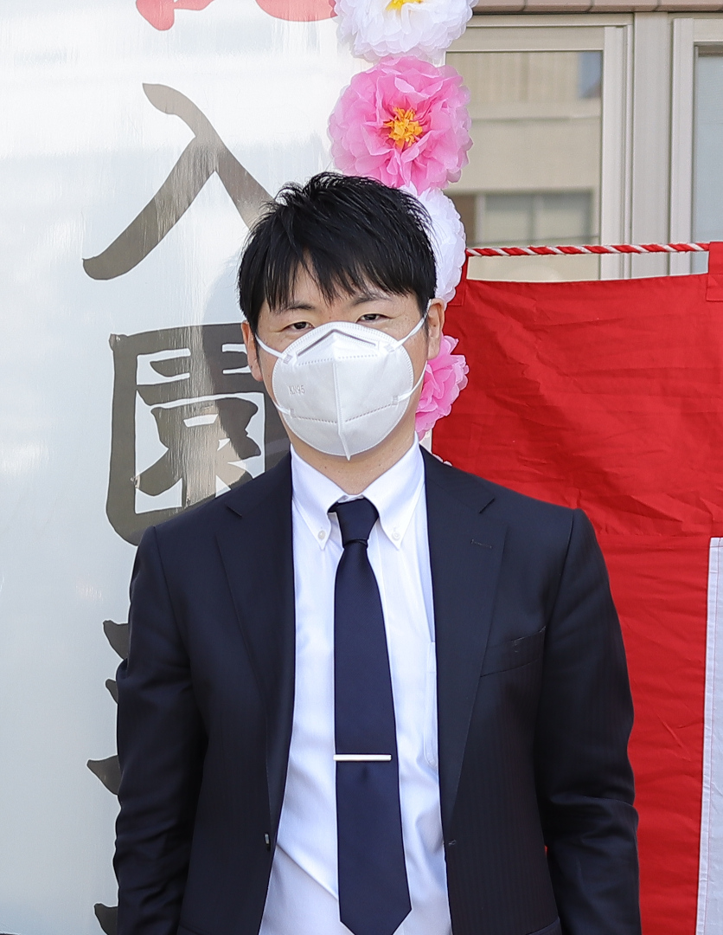
Who I am
Introduction >
Keisuke Takahashi
Cloud Solution Architect (Data&AI) at Microsoft Japan
Open Source Software enthusiast
English as a Second Language
Learned Chinese for two years
Have some Korean friends
Notes:
Here is my brief self-introduction. I’m Keisuke Takahashi. The pronunciation might be difficult for the speakers of languages that have clear and strong accents. You can put accent anywhere in my name as you like. KEI-suke, Kei-SU-ke, or Keisu-KE. I have been working at Microsoft for 1 year. My former job was a software engineer at a famous Japanese company group. And I have been working with Open-Source Software including PostgreSQL.

Slide 6
This presentation is for whom …
Introduction >
Already knows what character encoding is.
Uses PostgreSQL for data that may include non-ASCII characters.
Be interested in both PostgreSQL and foreign languages.
Notes:
I described targeted audience in the session. You are expected to already know character encodings, including UTF-8. And I guess you have some experiences about PostgreSQL. The session will also be fun for you if you are interested in foreign languages.

Slide 7
Today’s Goal
Introduction >
Learn the basics of Character Sets, Locale and Collation in PostgreSQL
Learn which locale / collation you should choose
Notes:
Here is today’s goal. I will briefly recap the localization features of PostgreSQL. And you can choose locale and collation along with your workload.

Slide 8


Azure Database for PostgreSQL deployment options
Introduction > Azure Database for PostgreSQL Basics >
Single Server
Flexible Server ^{NEW}
Hyperscale (Citus)
Fully-managed, single-node PostgreSQL database service with built-in HA
Example use cases
Transactional and operational analytics workloads
Apps requiring JSON, geospatial support, or full-text search
Cloud-native apps built with modern frameworks
Maximum control for your database with a simplified developer experience
Example use cases
Support for a variety of workloads with a new simplified architecture
High-performance apps utilizing zone co-location for low latency
Worry-free PostgreSQL in the cloud with an architecture built to scale out
Example use cases
Scaling PostgreSQL multi-tenant, SaaS applications
Real-time operational analytics
Building high throughput transactional apps
Notes:
Before entering the main topic, I’ll share you the description of Azure Database for PostgreSQL. Now it consists of three types of database servers, namely Single Server, Flexible Server, and Hyperscale. You know, Citus is used in Hyperscale. In the session, I’ll use all of them for comparison, or use Hyperscale for main environment.

Slide 9

The benefits of Azure Database for PostgreSQL
Introduction > Azure Database for PostgreSQL Basics >
Innovate with open-source tools and extensions
Maximize performance with a fully managed Azure service
Ultimate control and flexibility for databases
Build massively scalable PostgreSQL applications
Stay productive with full compatibility with community PostgreSQL and support for your favorite PostgreSQL extensions.
Focus on your application innovation, not database management. Enjoy AI-powered performance optimization and advanced security.
Enjoy maximum control and flexibility with custom maintenance windows, zone redundant high availability and additional configuration parameters for fine grained database tuning.
Scale with ease to hundreds of nodes, with no app rewrites. Save time by running transactions and analytics in one database and avoid the costs of manual sharding.
Single Server
Flexible Server ^{NEW}
Hyperscale (Citus)

Slide 10
Agenda
Introduction
A number of different character sets
Character Set Support
Locale-specific collation order
Locale Support
Collation Support
Notes:
Let’s get started with the main topics.

Slide 11
Default settings on Azure PostgreSQL
SELECT name, setting FROM pg_settings WHERE name IN ('server_encoding', 'dynamic_shared_memory_type')
Single Server
Flexible Server
Hyperscale
(Citus)
Notes:
It is worthy understanding the default settings of the environments. All Azure PostgreSQL products support UTF-8 as the default encoding despite of the differences of operating systems. Single Server runs on Windows. Flexible Server and Hyperscale run on Linux.

Slide 12
Default settings on Azure PostgreSQL
SELECT datname, datcollate, datctype FROM pg_database WHERE datname IN ('template1','template0')
Single Server
Flexible Server
Hyperscale
(Citus)
Notes:
In PostgreSQL, databases are created based on a database template. So, it is important to know the settings of each default template. There are differences among the three products.

Slide 13
Supported Character Sets (Server-side) #1-10
Character Set Basics in PostgreSQL >
Name | Language | ICU? | Bytes/​Char
UTF8 | all | Yes | 1–4
SQL_ASCII | any | No | 1
WIN1256 | Arabic | Yes | 1
LATIN7 | Baltic | Yes | 1
WIN1257 | Baltic | Yes | 1
LATIN8 | Celtic | Yes | 1
LATIN2 | Central European | Yes | 1
WIN1250 | Central European | Yes | 1
WIN866 | Cyrillic | Yes | 1
WIN1251 | Cyrillic | Yes | 1
Notes:
As you have seen, Hyperscale supports UTF-8. And generally speaking, PostgreSQL currently supports 34-character sets other than UTF-8 for server side encoding.

Slide 14
Supported Character Sets (Server-side) #11-20
Character Set Basics in PostgreSQL >
Name | Language | ICU? | Bytes/​Char
KOI8R | Cyrillic (Russian) | Yes | 1
KOI8U | Cyrillic (Ukrainian) | Yes | 1
WIN1253 | Greek | Yes | 1
WIN1255 | Hebrew | Yes | 1
EUC_JP | Japanese | Yes | 1–3
EUC_JIS_2004 | Japanese | No | 1–3
EUC_KR | Korean | Yes | 1–3
ISO_8859_6 | Latin/Arabic | Yes | 1
ISO_8859_5 | Latin/Cyrillic | Yes | 1
ISO_8859_7 | Latin/Greek | Yes | 1

Slide 15
Supported Character Sets (Server-side) #21-30
Character Set Basics in PostgreSQL >
Name | Language | ICU? | Bytes/​Char
ISO_8859_8 | Latin/Hebrew | Yes | 1
LATIN9 | LATIN1 with Euro and accents | Yes | 1
MULE_INTERNAL | Multilingual Emacs | No | 1–4
LATIN6 | Nordic | Yes | 1
LATIN4 | North European | Yes | 1
LATIN10 | Romanian | No | 1
EUC_CN | Simplified Chinese | Yes | 1–3
LATIN3 | South European | Yes | 1
WIN874 | Thai | No | 1
EUC_TW | Traditional Chinese, Taiwanese | Yes | 1–3

Slide 16
Supported Character Sets (Server-side) #31-35
Character Set Basics in PostgreSQL >
Name | Language | ICU? | Bytes/​Char
LATIN5 | Turkish | Yes | 1
WIN1254 | Turkish | Yes | 1
WIN1258 | Vietnamese | Yes | 1
LATIN1 | Western European | Yes | 1
WIN1252 | Western European | Yes | 1

Slide 17
Setting the Character Set
Character Set Basics in PostgreSQL >
* This operation is not available on
Azure PostgreSQL Hyperscale(Citus)
because Citus is a DB level extension.
CREATE DATABASE new_database TEMPLATE template0 ENCODING 'encoding' LC_CTYPE 'collation.encoding'
Example:
CREATE DATABASE my_db TEMPLATE template0 ENCODING 'UTF-8' LC_CTYPE 'ja_JP.UTF-8';
Result:
Notes:
If you want to set a character set for database, you need to specify it on database creation.

Slide 18
Setting the Character Set
Character Set Basics in PostgreSQL >
* This operation is not available on
Azure PostgreSQL Hyperscale(Citus)
because Citus is a DB level extension.
CREATE DATABASE new_database TEMPLATE template0 ENCODING 'encoding' LC_CTYPE 'collation.encoding'
Example:
CREATE DATABASE my_db TEMPLATE template0 ENCODING 'UTF-8' LC_CTYPE 'ja_JP.UTF-8';
Alternative:
$ createdb my_db --locale=japanese --template=template0
$ initdb --encoding=UTF=8
Notes:
You can do it both with SQL and PostgreSQL client command.

Slide 19
Agenda
Introduction
A number of different character sets
Character Set Support
Locale-specific collation order
Locale Support
Collation Support
Notes:
Next, locale and collation.

Slide 20
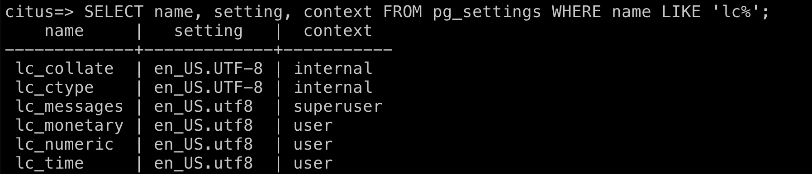
How to check your locale settings
Locale Basics in PostgreSQL >
SELECT name, setting, context FROM pg_settings WHERE name LIKE 'lc%'
Result on Azure Database for PostgreSQL Hyperscale (Citus):
Notes:
You can check your locale settings using the SQL.

Slide 21
Parameters
Locale Basics in PostgreSQL > How to check your locale settings >
Name | Description | Note
LC_COLLATE | String sort order
LC_CTYPE | Character classification (What is a letter? Its upper-case equivalent?)
LC_MESSAGES | Language of messages
LC_MONETARY | Formatting of currency amounts | This can also be configured with Azure Portal
LC_NUMERIC | Formatting of numbers | This can also be configured with Azure Portal
LC_TIME | Formatting of dates and times
Notes:
I described each parameter of the locale settings. And, monetary and numeric can be configured with Azure Portal via web browsers.

Slide 22
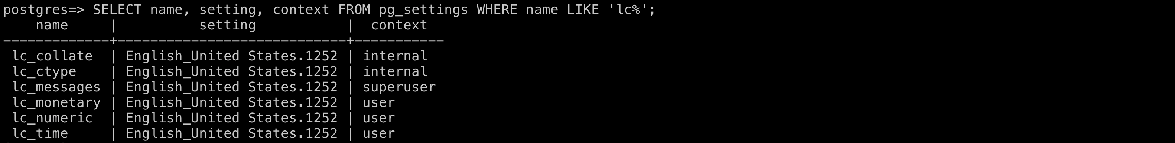
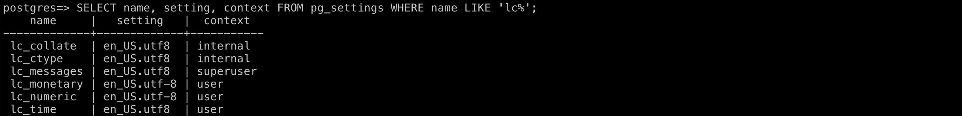
Default settings on Azure PostgreSQL
Locale Basics in PostgreSQL > How to check your locale settings >
Single Server
Flexible Server
Hyperscale
(Citus)
Notes:
Here is a comparison of default locale settings among Azure PostgreSQL products. All of them are the United States English with UTF-8 encodings.

Slide 23
How to set your locale
Locale Basics in PostgreSQL >
* This operation is not available on
Azure PostgreSQL Hyperscale(Citus)
because Citus is a DB level extension.
CREATE DATABASE new_database TEMPLATE template0 ENCODING 'encoding' LC_COLLATE 'collation.encoding' LC_CTYPE 'collation.encoding'
Example:
CREATE DATABASE my_db TEMPLATE template0 ENCODING 'UTF-8' LC_COLLATE 'ja_JP.UTF-8' LC_CTYPE 'ja_JP.UTF-8';
Result:
Notes:
You can set your locale when you create new database in the same way that we’ve seen the slide that describes how to set your encodings when you create a database.

Slide 24
How to set your locale
Locale Basics in PostgreSQL >
* This operation is not available on
Azure PostgreSQL Hyperscale(Citus)
because Citus is a DB level extension.
CREATE DATABASE new_database TEMPLATE template0 ENCODING 'encoding' LC_COLLATE 'collation.encoding' LC_CTYPE 'collation.encoding'
Example:
CREATE DATABASE my_db TEMPLATE template0 ENCODING 'UTF-8' LC_COLLATE 'ja_JP.UTF-8' LC_CTYPE 'ja_JP.UTF-8';
Alternative:
$ createdb ja --locale=japanese --template=template0
$ initdb --encoding=UTF=8 --locale=ja_JP.UTF=8

Slide 25
How to get Predefined Collations
Collation Basics in PostgreSQL >
SELECT * FROM pg_collation
Example:
SELECT collname, collprovider FROM pg_collation WHERE collname LIKE 'ja%';
Alternative:
\dOS+
Notes:
After talking about locale, now we will talk about collation. Collation is sorting order. PostgreSQL has a lot of predefined collations for many languages and regions. You can see them with the SQL.

Slide 26
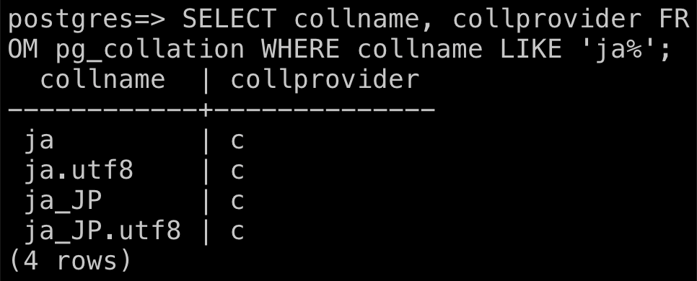
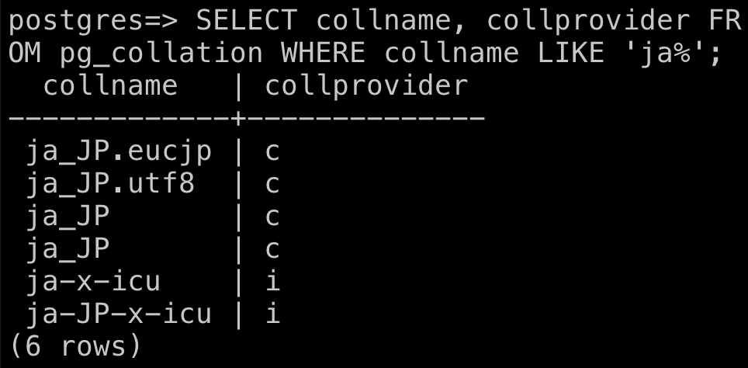
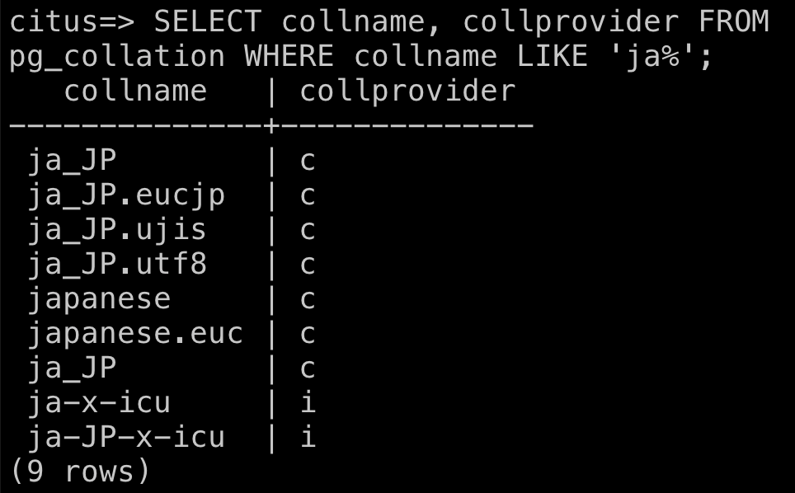
Predefined "ja" Collations on Azure PostgreSQL
Collation Basics in PostgreSQL > How to get Predefined Collations >
SELECT collname, collprovider FROM pg_collation WHERE collname LIKE 'ja%';
Single Server
Flexible Server
Hyperscale (Citus)
Notes:
In this slide, I’m showing you predefined Japanese collations in each Azure PostgreSQL product.

Slide 27
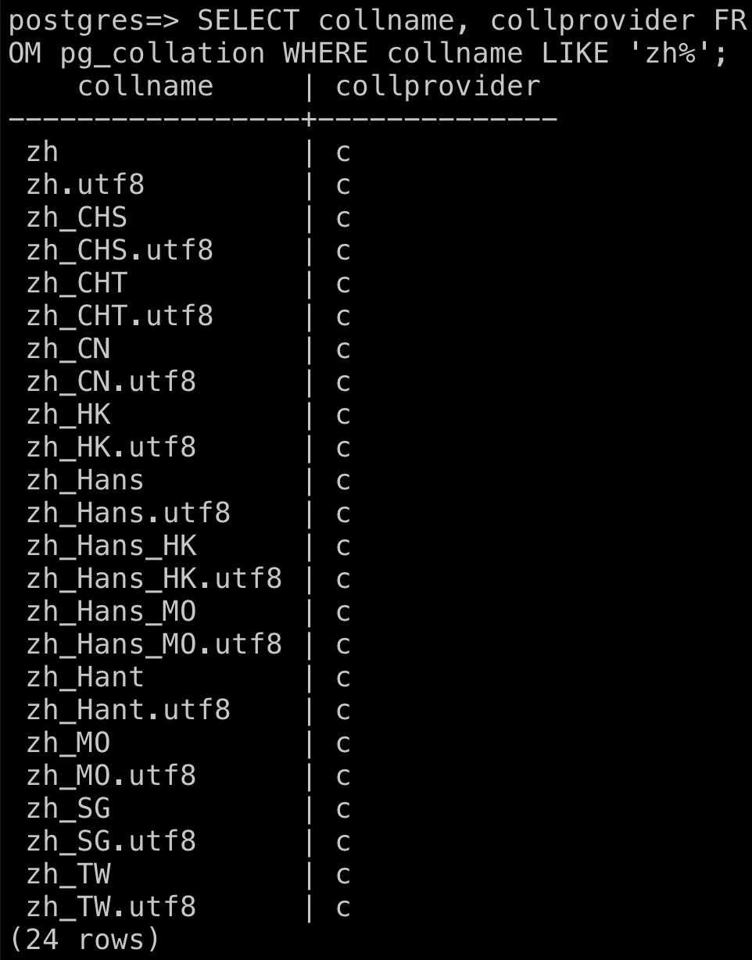
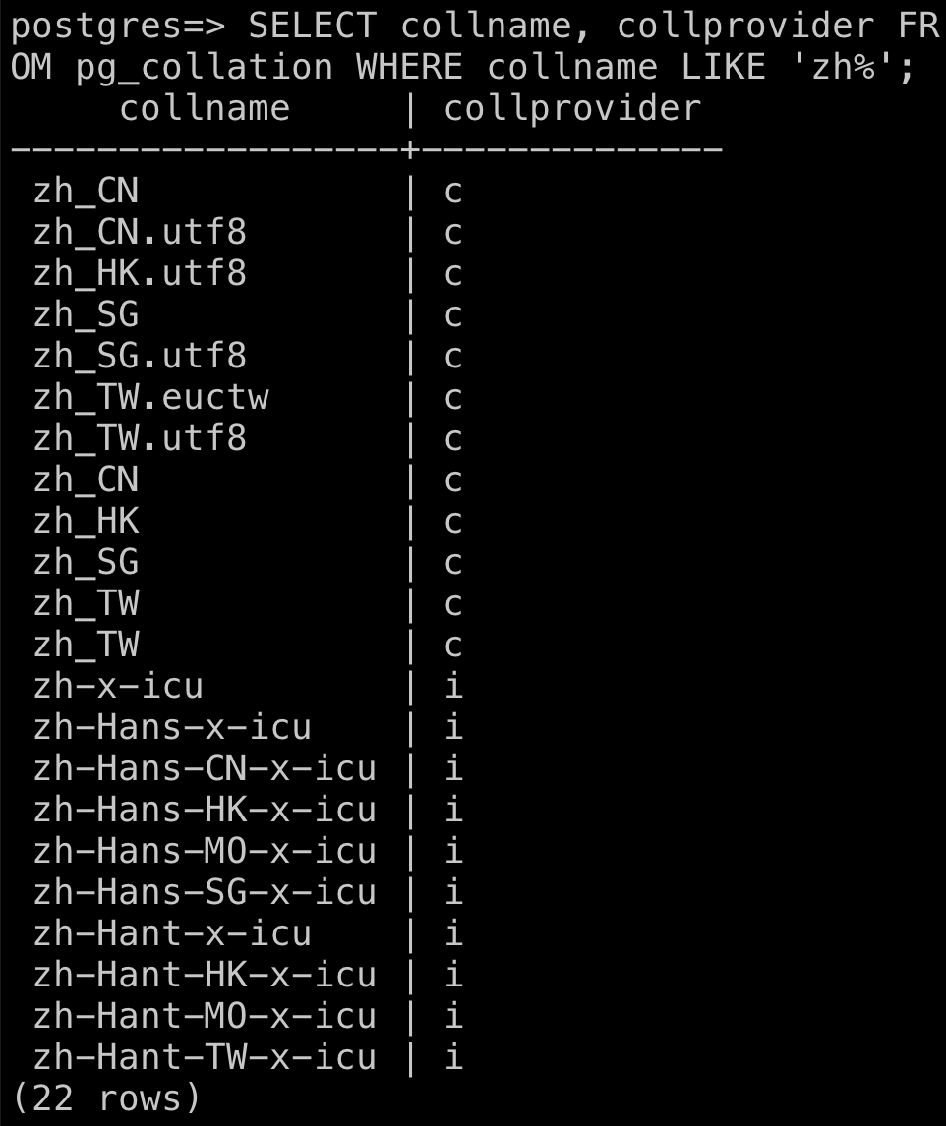
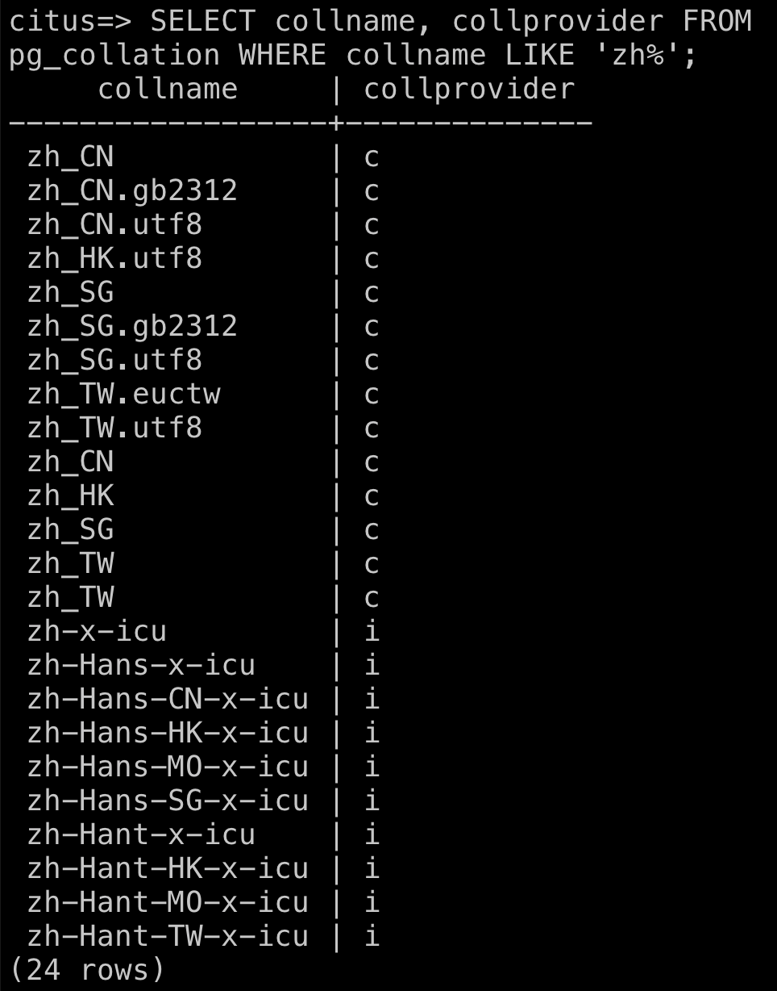
Predefined "zh" Collations on Azure PostgreSQL
Collation Basics in PostgreSQL > How to get Predefined Collations >
Single Server
Flexible Server
Hyperscale (Citus)
Notes:
For another example, you are seeing predefined Chinese collations. It is much more than the number of Japanese ones.

Slide 28
libc vs. ICU
Collation Basics in PostgreSQL >
libc
Old-school locale/collation provider of PostgreSQL
ICU
International Components for Unicode
Have been supported since PostgreSQL 10
User-defined locale/collation support
Notes:
In the examples, you’ve seen ‘collprovider’ column filled with ‘c’ or ‘I’. ‘C’ means libc, and ‘I’ means ICU. These are locale and collation providers. Libc is a traditional provider until PostgreSQL version 9. ICU is a new one and it is smart and flexible. The topic in this session will be mainly about ICU and I’m going to show you the benefits of the new collation provider.

Slide 29
Create ICU Database
Collation Basics in PostgreSQL >
* This operation is not available on
Azure PostgreSQL Hyperscale(Citus)
because Citus is a DB level extension.
CREATE DATABASE new_database ENCODING 'UTF-8' TEMPLATE template0 LC_COLLATE 'collation' LC_CTYPE 'collation'
Example:
CREATE DATABASE my_icu_db ENCODING 'UTF-8' LC_COLLATE 'ja-x-icu' LC_CTYPE 'ja-x-icu';
Notes:
Again, you can specify your encodings and collation when you create a database. To use an ICU collation, you can specify it in this timing.

Slide 30
Create ICU Template DB
Collation Basics in PostgreSQL >
* This operation is not available on
Azure PostgreSQL Hyperscale(Citus)
because Citus is a DB level extension.
CREATE DATABASE new_template ENCODING 'UTF-8' TEMPLATE template0 LC_COLLATE 'collation' LC_CTYPE 'collation'
CREATE DATABASE new_database TEMPLATE new_template
Example:
CREATE DATABASE template_ja_x_icu ENCODING 'UTF-8' TEMPLATE template0 LC_COLLATE 'ja-x-icu' LC_CTYPE 'ja-x-icu';
CREATE DATABASE my_db TEMPLATE template_ja_x_icu;
Notes:
You can also create new database template with your ICU collation. It is very useful when you create multiple databases with your collation.

Slide 31
Set Collation for the Column
Collation Basics in PostgreSQL >
CREATE TABLE tablename (
colname1 type COLLATE "collation",
colname2 type COLLATE "collation",
...
)
Example:
CREATE TABLE users (
id SERIAL PRIMARY KEY,
name VARCHAR(255) COLLATE "ja-x-icu");
Notes:
You can also specify your collation for columns in new table.

Slide 32
Specify Collation on SELECT
Collation Basics in PostgreSQL
SELECT * FROM table ORDER BY column COLLATE "collation"
Example:
SELECT * FROM mytable ORDER BY mycol COLLATE "ja-x-icu";
Notes:
And you can also specify your collation on SELECT statement on-the-fly.

Slide 33
Sorting Experiments
Environment
Azure Database for PostgreSQL Hyperscale (Citus)
PostgreSQL 14
Citus 10.2
Basic tier
West US 2
Notes:
We have learned the basics of character sets, locale, and collation in PostgreSQL. Next, I’ll show you sorting results with individual collations through experiments. The environment is Hyperscale.

Slide 34
Sorting Experiments
10 collations
English
en_US.utf8, en-US-x-icu
Japanese
ja_JP.utf8, ja-x-icu, ja-JP-x-icu
Chinese
zh_CN.utf8, zh-x-icu, zh-Hans-x-icu, zh-Hant-x-icu
Notes:
I conducted experiments on 10 collations for English, Japanese, and Chinese, including both libc and ICU collations.

Slide 35
Sorting Experiments
165 unicode characters / combinations
Latin
Japanese (Hiragana, Katakana, Kanji, Simbol, etc.)
Chinese (Traditional, Simplified)
Hangul
Chữ Nôm
Arabic
Cyrillic
Notes:
In the experiments, I used 165 unicode characters or combinations which I picked up from huge number of characters. I hope they will cover almost all of language population or usages in Asia Pacific.

Slide 36
Tested Characters
Sorting Experiments >
Character | UTF-8 (hex) | Description
a | 0x61 | Latin Small Letter a
z | 0x7A | Latin Small Letter z
A | 0x41 | Latin Capital Letter A
Z | 0x5A | Latin Capital Letter Z
ａ | 0xEF 0xBD 0x81 | Fullwidth Latin Capital Letter a
ｚ | 0xEF 0xBD 0x9A | Fullwidth Latin Capital Letter z
Ａ | 0xEF 0xBC 0xA1 | Fullwidth Latin Capital Letter A
Ｚ | 0xEF 0xBC 0xBA | Fullwidth Latin Capital Letter Z
Notes:
Here is the list of 165 characters or combinations. I understand Japanese language has both huge number of characters and complex combinations.

Slide 37
Tested Characters
Sorting Experiments >
Character | UTF-8 (hex) | Description
0 | 0x30 | ASCII Digit Zero
9 | 0x39 | ASCII Digit Nine
０ | 0xEF 0xBC 0x90 | Fullwidth Digit Zero
９ | 0xEF 0xBC 0x99 | Fullwidth Digit Nine
⓪ | 0xE2 0x93 0xAA | Circled Digit Zero
㊿ | 0xE3 0x8A 0xBF | Circled Number Fifty
㉌ | 0xE3 0x89 0x8C | Circled Number Fifty on Black Square

Slide 38
Tested Characters
Sorting Experiments >
Character | UTF-8 (hex) | Description
① | 0xE2 0x91 0xA0 | Circled Digit One
❶ | 0xE2 0x9D 0xB6 | Dingbat Negative Circled Digit One
Ⅰ | 0xE2 0x85 0xA0 | Roman Numeral One
ⅰ | 0xE2 0x85 0xB0 | Small Roman Numeral One
⑴ | 0xE2 0x91 0xB4 | Parenthesized Digit One
(1) | 0x28 0x31 0x29 | Digit One in Parenthesisses
一 | 0xE4 0xB8 0x80 | CJK Ideograph, First
壱 | 0xE5 0xA3 0xB1 | Number One

Slide 39
Tested Characters
Sorting Experiments >
Character | UTF-8 (hex) | Description
⑨ | 0xE2 0x91 0xA8 | Circled Digit Nine
❾ | 0xE2 0x9D 0xBE | Dingbat Negative Circled Digit Nine
Ⅸ | 0xE2 0x85 0xA8 | Roman Numeral Nine
ⅸ | 0xE2 0x85 0xB8 | Small Roman Numeral Nine
⑼ | 0xE2 0x91 0xBC | Parenthesized Digit Nine
(9) | 0x28 0x39 0x29 | Digit Nine in Parenthesisses
九 | 0xE4 0xB9 0x9D | Nine
⒐ | 0xE2 0x92 0x90 | Digit Nine Full Stop
9. | 0x91 0x2E | Digit Nine and Full Stop

Slide 40
Tested Characters
Sorting Experiments >
Character | UTF-8 (hex) | Description
Ⅶ | 0xE2 0x85 0xA6 | Roman Numeral Seven
ⅶ | 0xE2 0x85 0xB6 | Small Roman Numeral Seven
VII | 0x56 0x49 0x49 | Latin Capital Letter V, I, I
vii | 0x76 0x69 0x69 | Latin Small Letter v, i, i
Ⅻ | 0xE2 0x85 0xAB | Roman Numeral Twelve
ⅻ | 0xE2 0x85 0xBB | Small Roman Numeral Twelve
XII | 0x58 0x49 0x49 | Latin Capital Letter X, I, I
xii | 0x78 0x69 0x69 | Latin Small Letter x, i, i

Slide 41
Tested Characters
Sorting Experiments >
Character | UTF-8 (hex) | Description
α | 0xCE 0xB1 | Greek Small Letter Alpha
ω | 0xCF 0x89 | Greek Small Letter Omega
Α | 0xCE 0x91 | Greek Capital Letter Alpha
Ω | 0xCE 0xA9 | Greek Capital Letter Omega

Slide 42
Tested Characters
Sorting Experiments >
Character | UTF-8 (hex) | Description
(a) | 0x28 0x61 0x29 | "a" in parenthesisses
(z) | 0x28 0x7A 0x29 | "z" in parenthesisses
{a} | 0x7B 0x61 0x7D | "a" in Curly Brackets
[a] | 0x5B 0x61 0x5D | "a" in Square Brackets
（a） | 0xEF 0xBC 0x88 0x61 0xEF 0xBC 0x89 | "a" in Fullwidth parenthesisses
（z） | 0xEF 0xBC 0x88 0x7A 0xEF 0xBC 0x89 | "z" in Fullwidth parenthesisses

Slide 43
Tested Characters
Sorting Experiments >
Character | UTF-8 (hex) | Description
｛a｝ | 0xEF 0xBD 0x9B 0x61 0xEF 0xBD 0x9D | "a" in Fullwidth Curly Brackets
［a］ | 0xEF 0xBC 0xBB 0x61 0xEF 0xBC 0xBD | "a" in Fullwidth Square Brackets
【a】 | 0xE3 0x80 0x90 0x61 0xE3 0x80 0x91 | "a" in Black Lenticular Brackets

Slide 44
Tested Characters
Sorting Experiments >
Character | UTF-8 (hex) | Description
a | 0x20 0x61 | "a" after a space
a | 0xE3 0x80 0x80 0x61 | "a" after an Ideographic space
_a | 0x5F 0x61 | "a" after an underscore
＿a | 0xEF 0xBC 0xBF 0x61 | "a" after a Fullwidth Low Line
/a | 0x2F 0x61 | "a" after a Solidus
／a | 0xEF 0xBC 0x8F 0x61 | "a" after a Fullwidth Solidus

Slide 45
Tested Characters
Sorting Experiments >
Character | UTF-8 (hex) | Description
あ | 0xE3 0x81 0x82 | Hiragana Letter A
ア | 0xE3 0x82 0xA2 | Katakana Letter A
ｱ | 0xEF 0xBD 0xB1 | Halfwidth Katakana Letter A
ん | 0xE3 0x82 0x93 | Hiragana Letter N
ン | 0xE3 0x83 0xB3 | Katakana Letter N
ﾝ | 0xEF 0xBE 0x9D | Halfwidth Katakana Letter N

Slide 46
Tested Characters
Sorting Experiments >
Character | UTF-8 (hex) | Description
は | 0xE3 0x81 0xAF | Hiragana Letter Ha
ば | 0xE3 0x81 0xB0 | Hiragana Letter Ba
は゛ | 0xE3 0x81 0xB0 0xE3 0x82 0x9B | Hiragana Letter Ha and Voiced Sound Mark
ぱ | 0xE3 0x81 0xB1 | Hiragana Letter Pa
はﾟ | 0xE3 0x81 0xB0 0xE3 0x82 0x9C | Hiragana Letter Ha and Semi-voiced Sound Mark

Slide 47
Tested Characters
Sorting Experiments >
Character | UTF-8 (hex) | Description
ハ | 0xE3 0x83 0x8F | Katakana Letter Ha
バ | 0xE3 0x83 0x90 | Katakana Letter Ba
ハ゛ | 0xE3 0x83 0x8F 0xE3 0x82 0x9B | Katakana Letter Ha and Voiced Sound Mark
パ | 0xE3 0x83 0x91 | Katakana Letter Pa
ﾊ | 0xEF 0xBE 0x8A | Halfwidth Katakana Letter Ha
ﾊﾞ | 0xEF 0xBE 0x8A 0xEF 0xBE 0x9E | Halfwidth Katakana Letter Ha and Halfwidth Katakana Voiced Sound Mark
ﾊﾟ | 0xEF 0xBE 0x8A 0xEF 0xBE 0x9F | Halfwidth Katakana Letter Ha and Halfwidth Katakana Semi-voiced Sound Mark

Slide 48
Tested Characters
Sorting Experiments >
Character | UTF-8 (hex) | Description
あつ | 0xE3 0x81 0x82 0xE3 0x81 0xA4 | Hiragana Letter A and Tu
あっ | 0xE3 0x81 0x82 0xE3 0x81 0xA3 | Hiragana Letter A and Small Tu
ああ | 0xE3 0x81 0x82 0xE3 0x81 0x82 | Hiragana Letter A and A
あぁ | 0xE3 0x81 0x82 0xE3 0x81 0x81 | Hiragana Letter A and Small A
あゝ | 0xE3 0x81 0x82 0xE3 0x82 0x9D | Hiragana Letter A and Hiragana Iteration Mark

Slide 49
Tested Characters
Sorting Experiments >
Character | UTF-8 (hex) | Description
あー | 0xE3 0x81 0x82 0xE3 0x83 0xBC | Hiragana Letter A and Prolonged Sound Mark
あ- | 0xE3 0x81 0x82 0x2D | Hiragana Letter A and Hyphen/Minus
あ〜 | 0xE3 0x81 0x82 0xE3 0x80 0x9C | Hiragana Letter A and Wave Dash (macOS)
あ～ | 0xE3 0x81 0x82 0xEF 0xBD 0x9E | Hiragana Letter A and Fullwidth Tilde (Windows)
あ~ | 0xE3 0x81 0x82 0x7E | Hiragana Letter A and Tilde

Slide 50
Tested Characters
Sorting Experiments >
Character | UTF-8 (hex) | Description
あ… | 0xE3 0x81 0x82 0xE2 0x80 0xA6 | Hiragana Letter A and Horizontal Ellipsis
あﾞ | 0xE3 0x81 0x82 0xE3 0x82 0x9B | Hiragana Letter A and Voiced Sound Mark

Slide 51
Tested Characters
Sorting Experiments >
Character | UTF-8 (hex) | Description
キロ | 0xE3 0x82 0xAD 0xE3 0x83 0xAD | Katakana Letter Ki and Ro
ｷﾛ | 0xEF 0xBD 0xB7 0xEF 0xBE 0x9B | Halfwidth Katakana Letter Ki and Ro
㌔ | 0xE3 0x8C 0x94 | Square Kiro
km | 0x6B 0x6D | Latin Small Letter k and m
ｋｍ | 0xEF 0xBD 0x8B 0xEF 0xBD 0x8D | Fullwidth Latin Small Letter k and m
㎞ | 0xE3 0x8E 0x9E | Squre km

Slide 52
Tested Characters
Sorting Experiments >
Character | UTF-8 (hex) | Description
㌖ | 0xE3 0x8C 0x96 | Squre Kiromeetoru
粁 | 0xE7 0xB2 0x81 | Kilometre (Japanese)
cm | 0x63 0x6D | Latin Small Letter c and m
ｃｍ | 0xEF 0xBD 0x83 0xEF 0xBD 0x8D | Fullwidth Latin Small Letter c and m
㎝ | 0xE3 0x8E 0x9D | Squre cm
㌢ | 0xE3 0x8C 0xA2 | Squre Senti
糎 | 0xE7 0xB3 0x8E | Centimetre (Japanese)

Slide 53
Tested Characters
Sorting Experiments >
Character | UTF-8 (hex) | Description
kg | 0x6B 0x67 | Latin Small Letter k and g
ｋｇ | 0xEF 0xBD 0x8B 0xEF 0xBD 0x87 | Fullwidth Latin Small Letter k and g
㎏ | 0xE3 0x8E 0x8F | Squre kg
㌕ | 0xE3 0x8C 0x95 | Squre Kiroguramu
瓩 | 0xE7 0x93 0xA9 | Kilogram (Japanese)

Slide 54
Tested Characters
Sorting Experiments >
Character | UTF-8 (hex) | Description
(株) | 0x28 0xE6 0xA0 0xAA 0x29 | numerary adjunct for trees; root, in Parenthesisses
（株） | 0xEF 0xBC 0x88 0xE6 0xA0 0xAA 0xEF 0xBC 0x89 | numerary adjunct for trees; root, in Fullwidth parenthesisses
㈱ | 0xE3 0x88 0xB1 | Parenthesized Ideograph Stock

Slide 55
Tested Characters
Sorting Experiments >
Character | UTF-8 (hex) | Description
畑 | 0xE7 0x95 0x91 | dry (as opposed to rice) field; used in Japanese names
畠 | 0xE7 0x95 0xA0 | garden, field, farm, plantation
働 | 0xE5 0x83 0x8D | labor; work
匂 | 0xE5 0x8C 0x82 | fragrance, smell
♡ | 0xE2 0x99 0xA1 | White Heart Suit
💓 | N/A

Slide 56
Tested Characters
Sorting Experiments >
Character | UTF-8 (hex) | Description
! | 0x21 | Exclamation Mark
！ | 0xEF 0xBC 0x81 | Fullwidth Exclamation Mark
@ | 0x40 | Commercial At
＠ | 0xEF 0xBC 0xA0 | Fullwidth Commercial At
# | 0x23 | Number Sign
＃ | 0xEF 0xBC 0x83 | Fullwidth Number Sign
$ | 0x24 | Doller Sign
＄ | 0xEF 0xBC 0x84 | Fullwidth Doller Sign
? | 0x3F | Question Mark

Slide 57
Tested Characters
Sorting Experiments >
Character | UTF-8 (hex) | Description
？ | 0xEF 0xBC 0x9F | Fullwidth Question Mark
, | 0x2C | Comma
， | 0xEF 0xBC 0x8C | Fullwidth Comma
. | 0x2E | Full Stop
． | 0xEF 0xBC 0x8E | Fullwidth Full Stop
、 | 0xE3 0x80 0x81 | Ideographic Comma
。 | 0xE3 0x80 0x82 | Ideographic Full Stop
､ | 0xEF 0xBD 0xA4 | Halfwidth Ideographic Comma
｡ | 0xEF 0xBD 0xA1 | Halfwidth Ideographic Full Stop

Slide 58
Tested Characters
Sorting Experiments >
Character | UTF-8 (hex) | Description
高 | 0xE9 0xAB 0x98 | high, tall; lotfy elevated
髙 | 0xE9 0xAB 0x99 | Variant of 高 U+9ADB, high, tall; lotfy elevated
変 | 0xE5 0xA4 0x89 | change, transform, alter (Japanese)
變 | 0xE8 0xAE 0x8A | change, transform, alter (Traditional Chinese)
变 | 0xE5 0x8F 0x98 | change, transform, alter (Simplified Chinese)
総 | 0xE7 0xB7 0x8F | collect; overall, altogether (Japanese)
總 | 0xE7 0xB8 0xBD | collect; overall, altogether (Traditional Chinese)
总 | 0xE6 0x80 0xBB | collect; overall, altogether (Simplified Chinese)

Slide 59
Tested Characters
Sorting Experiments >
Character | UTF-8 (hex) | Description
가 | 0xEA 0xB0 0x80 | Hangul ga
히 | 0xED 0x9E 0x88 | Hangul hi
까 | 0xEA 0xB9 0x8C | Hangul kka
찌 | 0xEC 0xB0 0x8C | Hangul jji
𡨸 | N/A | Vietnamese Chữ Nôm
喃 | 0xE5 0x96 0x83 | Vietnamese Chữ Nôm
𢆥 | N/A | Vietnamese Chữ Nôm
𥪞 | N/A | Vietnamese Chữ Nôm

Slide 60
Tested Characters
Sorting Experiments >
Character | UTF-8 (hex) | Description
Ѐ | 0xD0 0x80 | Cyrillic Capital Letter Ie with Grave
Ё | 0xD0 0x81 | Cyrillic Capital Letter Io
Ӿ | 0xD3 0xBE | Cyrillic Capital Letter Ha with Stroke
ӿ | 0xD3 0xBF | Cyrillic Small Letter Ha with Stroke
Ä | 0xC3 0x84 | Latin Capital Letter A with Diaresis
ä | 0xC3 0xA4 | Latin Small Letter a with Diaresis
Ü | 0xC3 0x9C | Latin Capital Letter U with Diaresis
ü | 0xC3 0xBC | Latin Small Letter u with Diaresis

Slide 61
Tested Characters
Sorting Experiments >
Character | UTF-8 (hex) | Description
¡ | 0xC2 0xA1 | Inverted Exclamation Mark
¿ | 0xC2 0xBF | Inverted Question Mark
ٹ | 0xD9 0xB9 | Arabic Letter Tteh
ٺ | 0xD9 0xBA | Arabic Letter Tteheh
ے | 0xDB 0x92 | Arabic Letter Barree
ۓ | 0xDB 0x93 | Arabic Letter Barree with Hamza Above

Slide 62
Setup (on Citus Database)
Sorting Experiments >
CREATE TABLE t_en_US_utf8 (t text COLLATE "en_US.utf8");
CREATE TABLE t_en_US_x_icu (t text COLLATE "en-US-x-icu");
CREATE TABLE t_ja_JP_utf8 (t text COLLATE "ja_JP.utf8");
CREATE TABLE t_ja_x_icu (t text COLLATE "ja-x-icu");
CREATE TABLE t_ja_JP_x_icu (t text COLLATE "ja-JP-x-icu");
CREATE TABLE t_zh_CN_utf8 (t text COLLATE "zh_CN.utf8");
CREATE TABLE t_zh_x_icu (t text COLLATE "zh-x-icu");
CREATE TABLE t_zh_Hans_x_icu (t text COLLATE "zh-Hans-x-icu");
CREATE TABLE t_zh_Hant_x_icu (t text COLLATE "zh-Hant-x-icu");
Notes:
Here are the SQLs for preparing tables.

Slide 63
SELECT t FROM t_en_US_utf8 ORDER BY t;
Sorting Experiments > English Collation > libc >
(en_US.utf8)
#001 -008 | #009 -016 | #017 -024 | #025 -032 | #033 -040 | #041 -048 | #049 -056 | #057 -064 | #065 -072 | #073 -080 | #081 -088
, | # | ⅰ | ⒐ | は | ン | ㎏ | ＃ | ＠ | ﾊ | あ…
! | Ӿ | ⅶ | ⓪ | ば | ㈱ | ㎝ | ＄ | Ａ | ﾝ | あ〜
¡ | ӿ | ⅸ | ♡ | ぱ | ㉌ | ㎞ | ， | Ｚ | あ~ | あぁ
? | ٺ | ⅻ | ❶ | ん | ㊿ | 가 | ． | ａ | あ- | ああ
¿ | Ⅰ | ① | ❾ | ア | ㌔ | 까 | ０ | ｚ | 💓 | あっ
. | Ⅶ | ⑨ | 、 | ハ | ㌕ | 찌 | １ | ｡ | 𡨸 | あつ
@ | Ⅸ | ⑴ | 。 | バ | ㌖ | 히 | ９ | ､ | 𢆥 | あゝ
$ | Ⅻ | ⑼ | あ | パ | ㌢ | ！ | ？ | ｱ | 𥪞 | あー
(1/2)
Notes:
From here, I show you the results, orders of sorted characters or the combinations. The first result is about ‘en_US.utf8’ collation, which is the default collation in Azure PostgreSQL Flexible Server and Hyperscale Citus. I marked up strange points with pink rectangles. It’s based on my sense. For example, #056, fullwidth exclamation mark is far from regular exclamation mark at position #002.

Slide 64
SELECT t FROM t_en_US_utf8 ORDER BY t;
Sorting Experiments > English Collation > libc >
(en_US.utf8)
#089 -096 | #097 -104 | #105 -112 | #113 -120 | #121 -128 | #129 -136 | #137 -144 | #145 -152 | #153 -160 | #161 -168 | #169 -176
あ～ | ｋｍ | 9. | a | ä | VII | ۓ | 一 | 总 | 総
あﾞ | ｷﾛ | a | ／a | Ä | xii | ے | 九 | (株) | 總
は゛ | ﾊﾞ | a | ＿a | cm | XII | Α | 働 | （株） | 變
はﾟ | ﾊﾟ | _a | 【a】 | kg | z | α | 匂 | 瓩 | 高
キロ | 0 | /a | （a） | km | (z) | Ω | 变 | 畑 | 髙
ハ゛ | 1 | (a) | ［a］ | ü | （z） | ω | 喃 | 畠
ｃｍ | 9 | [a] | ｛a｝ | Ü | Z | Ѐ | 壱 | 粁
ｋｇ | (9) | {a} | A | vii | ٹ | Ё | 変 | 糎
(2/2)
Notes:
Each result is described in 2 slides separately, #001 to #088 in the first page, and the rest in the second page. Using ‘en_US.utf8’, three styles of Chinese letters, Japanese style, Traditional Chinese style, and Simplified Chinese style, are separated in the sorted results.

Slide 65
SELECT t FROM t_en_US_x_icu ORDER BY t;
Sorting Experiments > English Collation > ICU >
(en-US-x-icu)
#001 -008 | #009 -016 | #017 -024 | #025 -032 | #033 -040 | #041 -048 | #049 -056 | #057 -064 | #065 -072 | #073 -080 | #081 -088
a | ! | 。 | （z） | 【a】 | 💓 | ① | 9. | cm | ｋｇ | ⅶ
a | ！ | ｡ | (株) | @ | $ | ❶ | ⒐ | ｃｍ | ㎏ | VII
_a | ¡ | ⑴ | （株） | ＠ | ＄ | ㉌ | a | ㎝ | km | Ⅶ
＿a | ? | (9) | ㈱ | /a | 0 | ㊿ | ａ | ⅰ | ｋｍ | xii
, | ？ | ⑼ | [a] | ／a | ０ | 9 | A | Ⅰ | ㎞ | ⅻ
， | ¿ | (a) | ［a］ | # | ⓪ | ９ | Ａ | ⅸ | ü | XII
、 | . | （a） | {a} | ＃ | 1 | ⑨ | ä | Ⅸ | Ü | Ⅻ
､ | ． | (z) | ｛a｝ | ♡ | １ | ❾ | Ä | kg | vii | z
(1/2)
Notes:
Next, ‘en-US-x-icu’. It is an ICU collation for English in the United States, and the result looks very natural for me. All roman numerals are treated as alphabet, not number nor symbol.

Slide 66
SELECT t FROM t_en_US_x_icu ORDER BY t;
Sorting Experiments > English Collation > ICU >
(en-US-x-icu)
#089 -096 | #097 -104 | #105 -112 | #113 -120 | #121 -128 | #129 -136 | #137 -144 | #145 -152 | #153 -160 | #161 -168 | #169 -176
ｚ | Ё | 까 | あ〜 | あっ | は | パ | 九 | 瓩 | 高
Z | ӿ | 찌 | あ… | あつ | ハ | ﾊﾟ | 働 | 畑 | 髙
Ｚ | Ӿ | 히 | あ~ | キロ | ﾊ | は゛ | 匂 | 畠 | 𡨸
α | ٹ | あ | あ～ | ｷﾛ | ば | ハ゛ | 变 | 粁 | 𢆥
Α | ٺ | ア | あゝ | ㌔ | バ | ん | 喃 | 糎 | 𥪞
ω | ے | ｱ | あー | ㌕ | ﾊﾞ | ン | 壱 | 総
Ω | ۓ | あﾞ | あぁ | ㌖ | ぱ | ﾝ | 変 | 總
Ѐ | 가 | あ- | ああ | ㌢ | はﾟ | 一 | 总 | 變
(2/2)

Slide 67
SELECT t FROM t_ja_JP_utf8 ORDER BY t;
Sorting Experiments > Japanese Collation > libc >
(ja_JP.utf8)
#001 -008 | #009 -016 | #017 -024 | #025 -032 | #033 -040 | #041 -048 | #049 -056 | #057 -064 | #065 -072 | #073 -080 | #081 -088
Ѐ | Ⅶ | ⑨ | ㈱ | ㎝ | 히 | $ | 0 | XII | vii | ﾊ
Ӿ | Ⅸ | ⑴ | ㉌ | ㎞ | 💓 | (9) | 1 | Z | xii | ﾊﾞ
ӿ | Ⅻ | ⑼ | ㊿ | 变 | 𡨸 | (a) | 9 | [a] | z | ﾊﾟ
ٹ | ⅰ | ⒐ | ㌔ | 总 | 𢆥 | (z) | 9. | _a | {a} | ﾝ
ٺ | ⅶ | ⓪ | ㌕ | 髙 | 𥪞 | (株) | ? | a | ｡ | a
ے | ⅸ | ♡ | ㌖ | 가 | a | , | @ | cm | ､ | 、
ۓ | ⅻ | ❶ | ㌢ | 까 | ! | . | A | kg | ｱ | 。
Ⅰ | ① | ❾ | ㎏ | 찌 | # | /a | VII | km | ｷﾛ | ，
(1/2)
Notes:
Next, ‘ja_JP.utf8’. The result is quite different from ‘en_US.utf8’. And there looks some unnatural points for me. But I think it is better than ‘en_US.utf8’ in this experiment.

Slide 68
SELECT t FROM t_ja_JP_utf8 ORDER BY t;
Sorting Experiments > Japanese Collation > libc >
(ja_JP.utf8)
#089 -096 | #097 -104 | #105 -112 | #113 -120 | #121 -128 | #129 -136 | #137 -144 | #145 -152 | #153 -160 | #161 -168 | #169 -176
． | ［a］ | ９ | あ | あぁ | ば | パ | 壱 | 畑 | ¿
？ | ｛a｝ | Ａ | あ- | ああ | ぱ | ン | 粁 | 畠 | Ä
！ | 【a】 | Ｚ | あ~ | あっ | ん | Α | 九 | 変 | Ü
＿a | ＄ | ａ | あﾞ | あつ | ア | Ω | 高 | 喃 | ä
／a | ＃ | ｃｍ | あゝ | あ～ | キロ | α | 糎 | 變 | ü
（a） | ＠ | ｋｇ | あー | は | ハ | ω | 総 | 瓩
（z） | ０ | ｋｍ | あ〜 | はﾟ | ハ゛ | Ё | 働 | 總
（株） | １ | ｚ | あ… | は゛ | バ | 一 | 匂 | ¡
(2/2)

Slide 69
SELECT t FROM t_ja_x_icu ORDER BY t;
Sorting Experiments > Japanese Collation > ICU >
(ja-x-icu)
#001 -008 | #009 -016 | #017 -024 | #025 -032 | #033 -040 | #041 -048 | #049 -056 | #057 -064 | #065 -072 | #073 -080 | #081 -088
a | ! | 。 | （z） | 【a】 | 💓 | ① | 9. | cm | ｋｇ | ⅶ
a | ！ | ｡ | (株) | @ | $ | ❶ | ⒐ | ｃｍ | ㎏ | VII
_a | ¡ | ⑴ | （株） | ＠ | ＄ | ㉌ | a | ㎝ | km | Ⅶ
＿a | ? | (9) | ㈱ | /a | 0 | ㊿ | ａ | ⅰ | ｋｍ | xii
, | ？ | ⑼ | [a] | ／a | ０ | 9 | A | Ⅰ | ㎞ | ⅻ
， | ¿ | (a) | ［a］ | # | ⓪ | ９ | Ａ | ⅸ | ü | XII
、 | . | （a） | {a} | ＃ | 1 | ⑨ | ä | Ⅸ | Ü | Ⅻ
､ | ． | (z) | ｛a｝ | ♡ | １ | ❾ | Ä | kg | vii | z
(1/2)
Notes:
Next, ‘ja-x-icu’. The result looks natural for me, but I cannot say why the order rule of Chinese characters from #144 is like that.

Slide 70
SELECT t FROM t_ja_x_icu ORDER BY t;
Sorting Experiments > Japanese Collation > ICU >
(ja-x-icu)
#089 -096 | #097 -104 | #105 -112 | #113 -120 | #121 -128 | #129 -136 | #137 -144 | #145 -152 | #153 -160 | #161 -168 | #169 -176
ｚ | Ё | 까 | あ〜 | あっ | は | はﾟ | 壱 | 畑 | 总
Z | ӿ | 찌 | あ… | あつ | ハ | ﾊﾟ | 粁 | 畠 | 髙
Ｚ | Ӿ | 히 | あ~ | キロ | ﾊ | は゛ | 九 | 変 | 𡨸
α | ٹ | あ | あ～ | ｷﾛ | ば | ハ゛ | 高 | 喃 | 𢆥
Α | ٺ | ア | あー | ㌔ | バ | ん | 糎 | 變 | 𥪞
ω | ے | ｱ | あぁ | ㌕ | ﾊﾞ | ン | 総 | 瓩
Ω | ۓ | あﾞ | あゝ | ㌖ | ぱ | ﾝ | 働 | 總
Ѐ | 가 | あ- | ああ | ㌢ | パ | 一 | 匂 | 变
(2/2)

Slide 71
SELECT t FROM t_ja_JP_x_icu ORDER BY t;
Sorting Experiments > Japanese Collation > ICU >
(ja-JP-x-icu)
#001 -008 | #009 -016 | #017 -024 | #025 -032 | #033 -040 | #041 -048 | #049 -056 | #057 -064 | #065 -072 | #073 -080 | #081 -088
a | ! | 。 | （z） | 【a】 | 💓 | ① | 9. | cm | ｋｇ | ⅶ
a | ！ | ｡ | (株) | @ | $ | ❶ | ⒐ | ｃｍ | ㎏ | VII
_a | ¡ | ⑴ | （株） | ＠ | ＄ | ㉌ | a | ㎝ | km | Ⅶ
＿a | ? | (9) | ㈱ | /a | 0 | ㊿ | ａ | ⅰ | ｋｍ | xii
, | ？ | ⑼ | [a] | ／a | ０ | 9 | A | Ⅰ | ㎞ | ⅻ
， | ¿ | (a) | ［a］ | # | ⓪ | ９ | Ａ | ⅸ | ü | XII
、 | . | （a） | {a} | ＃ | 1 | ⑨ | ä | Ⅸ | Ü | Ⅻ
､ | ． | (z) | ｛a｝ | ♡ | １ | ❾ | Ä | kg | vii | z
(The same as ja-x-icu)
(1/2)
Notes:
Next, ‘ja-JP-x-icu’. The result is the same as the previous ‘ja-x-icu’. That’s it about Japanese collations.

Slide 72
SELECT t FROM t_ja_JP_x_icu ORDER BY t;
Sorting Experiments > Japanese Collation > ICU >
(ja-JP-x-icu)
#089 -096 | #097 -104 | #105 -112 | #113 -120 | #121 -128 | #129 -136 | #137 -144 | #145 -152 | #153 -160 | #161 -168 | #169 -176
ｚ | Ё | 까 | あ〜 | あっ | は | はﾟ | 壱 | 畑 | 总
Z | ӿ | 찌 | あ… | あつ | ハ | ﾊﾟ | 粁 | 畠 | 髙
Ｚ | Ӿ | 히 | あ~ | キロ | ﾊ | は゛ | 九 | 変 | 𡨸
α | ٹ | あ | あ～ | ｷﾛ | ば | ハ゛ | 高 | 喃 | 𢆥
Α | ٺ | ア | あー | ㌔ | バ | ん | 糎 | 變 | 𥪞
ω | ے | ｱ | あぁ | ㌕ | ﾊﾞ | ン | 総 | 瓩
Ω | ۓ | あﾞ | あゝ | ㌖ | ぱ | ﾝ | 働 | 總
Ѐ | 가 | あ- | ああ | ㌢ | パ | 一 | 匂 | 变
(The same as ja-x-icu)
(2/2)

Slide 73
SELECT t FROM t_zh_CN_utf8 ORDER BY t;
Sorting Experiments > Chinese Collation > libc >
(zh_CN.utf8)
#001 -008 | #009 -016 | #017 -024 | #025 -032 | #033 -040 | #041 -048 | #049 -056 | #057 -064 | #065 -072 | #073 -080 | #081 -088
, | # | ⅰ | ⒐ | は | ン | ㎏ | 히 | ９ | ､ | 𢆥
! | Ӿ | ⅶ | ⓪ | ば | ㈱ | ㎝ | ！ | ？ | ｱ | 𥪞
¡ | ӿ | ⅸ | ♡ | ぱ | ㉌ | ㎞ | ＃ | ＠ | ﾊ | あ…
? | ٺ | ⅻ | ❶ | ん | ㊿ | 匂 | ＄ | Ａ | ﾝ | あ〜
¿ | Ⅰ | ① | ❾ | ア | ㌔ | 畠 | ， | Ｚ | あ~ | あぁ
. | Ⅶ | ⑨ | 、 | ハ | ㌕ | 가 | ． | ａ | あ- | ああ
@ | Ⅸ | ⑴ | 。 | バ | ㌖ | 까 | ０ | ｚ | 💓 | あっ
$ | Ⅻ | ⑼ | あ | パ | ㌢ | 찌 | １ | ｡ | 𡨸 | あつ
(Similar to en_US.utf8)
(1/2)
Notes:
From here, I’ll show you the results about Chinese collations. The first collation is ‘zh_CN.utf8’. It is similar to ‘en_US.utf8’. And I found the order of some of Chinese letters is different from that.

Slide 74
SELECT t FROM t_zh_CN_utf8 ORDER BY t;
Sorting Experiments > Chinese Collation > libc >
(zh_CN.utf8)
#089 -096 | #097 -104 | #105 -112 | #113 -120 | #121 -128 | #129 -136 | #137 -144 | #145 -152 | #153 -160 | #161 -168 | #169 -176
あゝ | ｃｍ | 9 | [a] | ｛a｝ | Ü | Z | Ѐ | 髙 | 壱
あー | ｋｇ | (9) | {a} | A | vii | ٹ | Ё | 九 | (株)
あ～ | ｋｍ | 9. | a | ä | VII | ۓ | 变 | 糎 | （株）
あﾞ | ｷﾛ | a | ／a | Ä | xii | ے | 変 | 喃 | 总
は゛ | ﾊﾞ | a | ＿a | cm | XII | Α | 變 | 瓩 | 總
はﾟ | ﾊﾟ | _a | 【a】 | kg | z | α | 総 | 粁
キロ | 0 | /a | （a） | km | (z) | Ω | 働 | 畑
ハ゛ | 1 | (a) | ［a］ | ü | （z） | ω | 高 | 一
(Similar to en_US.utf8)
(2/2)

Slide 75
SELECT t FROM t_zh_x_icu ORDER BY t;
Sorting Experiments > Chinese Collation > ICU >
(zh-x-icu)
#001 -008 | #009 -016 | #017 -024 | #025 -032 | #033 -040 | #041 -048 | #049 -056 | #057 -064 | #065 -072 | #073 -080 | #081 -088
a | ! | 。 | （z） | 【a】 | 💓 | ① | 9. | cm | ｋｇ | ⅶ
a | ！ | ｡ | ㈱ | @ | $ | ❶ | ⒐ | ｃｍ | ㎏ | VII
_a | ¡ | ⑴ | (株) | ＠ | ＄ | ㉌ | a | ㎝ | km | Ⅶ
＿a | ? | (9) | （株） | /a | 0 | ㊿ | ａ | ⅰ | ｋｍ | xii
, | ？ | ⑼ | [a] | ／a | ０ | 9 | A | Ⅰ | ㎞ | ⅻ
， | ¿ | (a) | ［a］ | # | ⓪ | ９ | Ａ | ⅸ | ü | XII
、 | . | （a） | {a} | ＃ | 1 | ⑨ | ä | Ⅸ | Ü | Ⅻ
､ | ． | (z) | ｛a｝ | ♡ | １ | ❾ | Ä | kg | vii | z
(Similar to ja-x-icu)
(1/2)
Notes:
Next, ‘zh-x-icu’. This is like ‘ja-x-icu’, and the order of parenthesized stock characters is different from that.

Slide 76
SELECT t FROM t_zh_x_icu ORDER BY t;
Sorting Experiments > Chinese Collation > ICU >
(zh-x-icu)
#089 -096 | #097 -104 | #105 -112 | #113 -120 | #121 -128 | #129 -136 | #137 -144 | #145 -152 | #153 -160 | #161 -168 | #169 -176
ｚ | Ё | 까 | あ〜 | あっ | は | パ | 变 | 喃 | 総
Z | ӿ | 찌 | あ… | あつ | ハ | ﾊﾟ | 変 | 瓩 | 總
Ｚ | Ӿ | 히 | あ~ | キロ | ﾊ | は゛ | 變 | 粁 | 𡨸
α | ٹ | あ | あ～ | ｷﾛ | ば | ハ゛ | 働 | 畑 | 𢆥
Α | ٺ | ア | あゝ | ㌔ | バ | ん | 高 | 畠 | 𥪞
ω | ے | ｱ | あー | ㌕ | ﾊﾞ | ン | 髙 | 一
Ω | ۓ | あﾞ | あぁ | ㌖ | ぱ | ﾝ | 九 | 壱
Ѐ | 가 | あ- | ああ | ㌢ | はﾟ | 匂 | 糎 | 总
(2/2)

Slide 77
SELECT t FROM t_zh_Hans_x_icu ORDER BY t;
Sorting Experiments > Chinese Collation > ICU >
(zh-Hans-x-icu)
#001 -008 | #009 -016 | #017 -024 | #025 -032 | #033 -040 | #041 -048 | #049 -056 | #057 -064 | #065 -072 | #073 -080 | #081 -088
a | ! | 。 | （z） | 【a】 | 💓 | ① | 9. | cm | ｋｇ | ⅶ
a | ！ | ｡ | ㈱ | @ | $ | ❶ | ⒐ | ｃｍ | ㎏ | VII
_a | ¡ | ⑴ | (株) | ＠ | ＄ | ㉌ | a | ㎝ | km | Ⅶ
＿a | ? | (9) | （株） | /a | 0 | ㊿ | ａ | ⅰ | ｋｍ | xii
, | ？ | ⑼ | [a] | ／a | ０ | 9 | A | Ⅰ | ㎞ | ⅻ
， | ¿ | (a) | ［a］ | # | ⓪ | ９ | Ａ | ⅸ | ü | XII
、 | . | （a） | {a} | ＃ | 1 | ⑨ | ä | Ⅸ | Ü | Ⅻ
､ | ． | (z) | ｛a｝ | ♡ | １ | ❾ | Ä | kg | vii | z
(1/2)
Notes:
Next, ‘zh-Hans-x-icu’, which is a Chinese ICU collation for Simplified Chinese.

Slide 78
SELECT t FROM t_zh_Hans_x_icu ORDER BY t;
Sorting Experiments > Chinese Collation > ICU >
(zh-Hans-x-icu)
#089 -096 | #097 -104 | #105 -112 | #113 -120 | #121 -128 | #129 -136 | #137 -144 | #145 -152 | #153 -160 | #161 -168 | #169 -176
ｚ | Ё | 까 | あ〜 | あっ | は | パ | 变 | 喃 | 総
Z | ӿ | 찌 | あ… | あつ | ハ | ﾊﾟ | 変 | 瓩 | 總
Ｚ | Ӿ | 히 | あ~ | キロ | ﾊ | は゛ | 變 | 粁 | 𡨸
α | ٹ | あ | あ～ | ｷﾛ | ば | ハ゛ | 働 | 畑 | 𢆥
Α | ٺ | ア | あゝ | ㌔ | バ | ん | 高 | 畠 | 𥪞
ω | ے | ｱ | あー | ㌕ | ﾊﾞ | ン | 髙 | 一
Ω | ۓ | あﾞ | あぁ | ㌖ | ぱ | ﾝ | 九 | 壱
Ѐ | 가 | あ- | ああ | ㌢ | はﾟ | 匂 | 糎 | 总
(2/2)
Notes:
The biggest point is the order of Chinese letters. It is different from the Chinese ICU collation for Traditional Chinese under ‘zh-Hant-x-icu’ collation.

Slide 79
SELECT t FROM t_zh_Hant_x_icu ORDER BY t;
Sorting Experiments > Chinese Collation > ICU >
(zh-Hant-x-icu)
#001 -008 | #009 -016 | #017 -024 | #025 -032 | #033 -040 | #041 -048 | #049 -056 | #057 -064 | #065 -072 | #073 -080 | #081 -088
a | ! | 。 | （z） | 【a】 | 💓 | ① | 9. | cm | ｋｇ | ⅶ
a | ！ | ｡ | ㈱ | @ | $ | ❶ | ⒐ | ｃｍ | ㎏ | VII
_a | ¡ | ⑴ | (株) | ＠ | ＄ | ㉌ | a | ㎝ | km | Ⅶ
＿a | ? | (9) | （株） | /a | 0 | ㊿ | ａ | ⅰ | ｋｍ | xii
, | ？ | ⑼ | [a] | ／a | ０ | 9 | A | Ⅰ | ㎞ | ⅻ
， | ¿ | (a) | ［a］ | # | ⓪ | ９ | Ａ | ⅸ | ü | XII
、 | . | （a） | {a} | ＃ | 1 | ⑨ | ä | Ⅸ | Ü | Ⅻ
､ | ． | (z) | ｛a｝ | ♡ | １ | ❾ | Ä | kg | vii | z
(Similar to zh-Hans-x-icu)
(1/2)

Slide 80
SELECT t FROM t_zh_Hant_x_icu ORDER BY t;
Sorting Experiments > Chinese Collation > ICU >
(zh-Hant-x-icu)
#089 -096 | #097 -104 | #105 -112 | #113 -120 | #121 -128 | #129 -136 | #137 -144 | #145 -152 | #153 -160 | #161 -168 | #169 -176
ｚ | Ё | 까 | あ〜 | あっ | は | パ | 九 | 粁 | 總
Z | ӿ | 찌 | あ… | あつ | ハ | ﾊﾟ | 匂 | 畠 | 變
Ｚ | Ӿ | 히 | あ~ | キロ | ﾊ | は゛ | 壱 | 高 | 𡨸
α | ٹ | あ | あ～ | ｷﾛ | ば | ハ゛ | 变 | 髙 | 𢆥
Α | ٺ | ア | あゝ | ㌔ | バ | ん | 瓩 | 喃 | 𥪞
ω | ے | ｱ | あー | ㌕ | ﾊﾞ | ン | 変 | 働
Ω | ۓ | あﾞ | あぁ | ㌖ | ぱ | ﾝ | 总 | 総
Ѐ | 가 | あ- | ああ | ㌢ | はﾟ | 一 | 畑 | 糎
(Similar to zh-Hans-x-icu)
(2/2)
Notes:
Which collation and the sort order do you feel the most natural for you or your workload?

Slide 81
libc vs. ICU (English)
Cost Comparison > By EXPLAIN >
libc (en_US.utf8)
ICU (en-US-x-icu)
Notes:
From here, let’s see the performance of each collation. I got calculated costs using EXPLAIN and measured the actual performances using ANALYZE. I conducted the tests not only for tables where each collation is specified when creating tables but also for queries specifying collations on-the-fly.

Slide 82
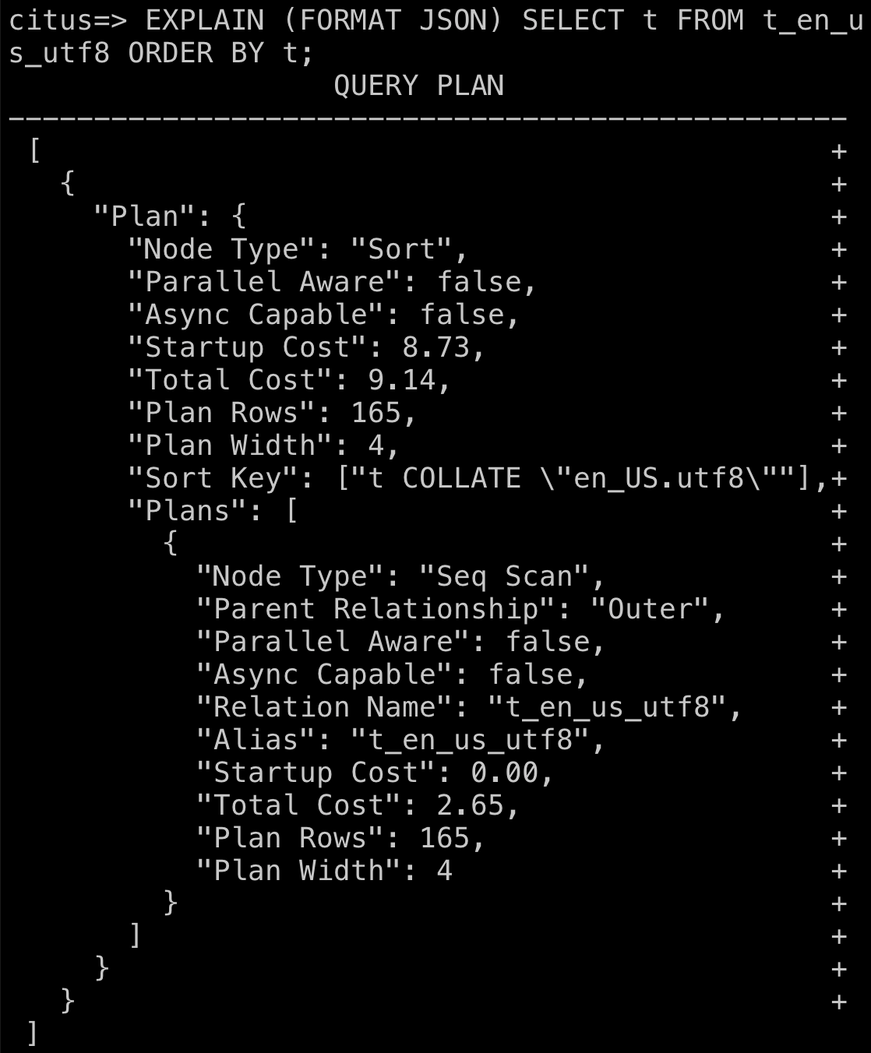
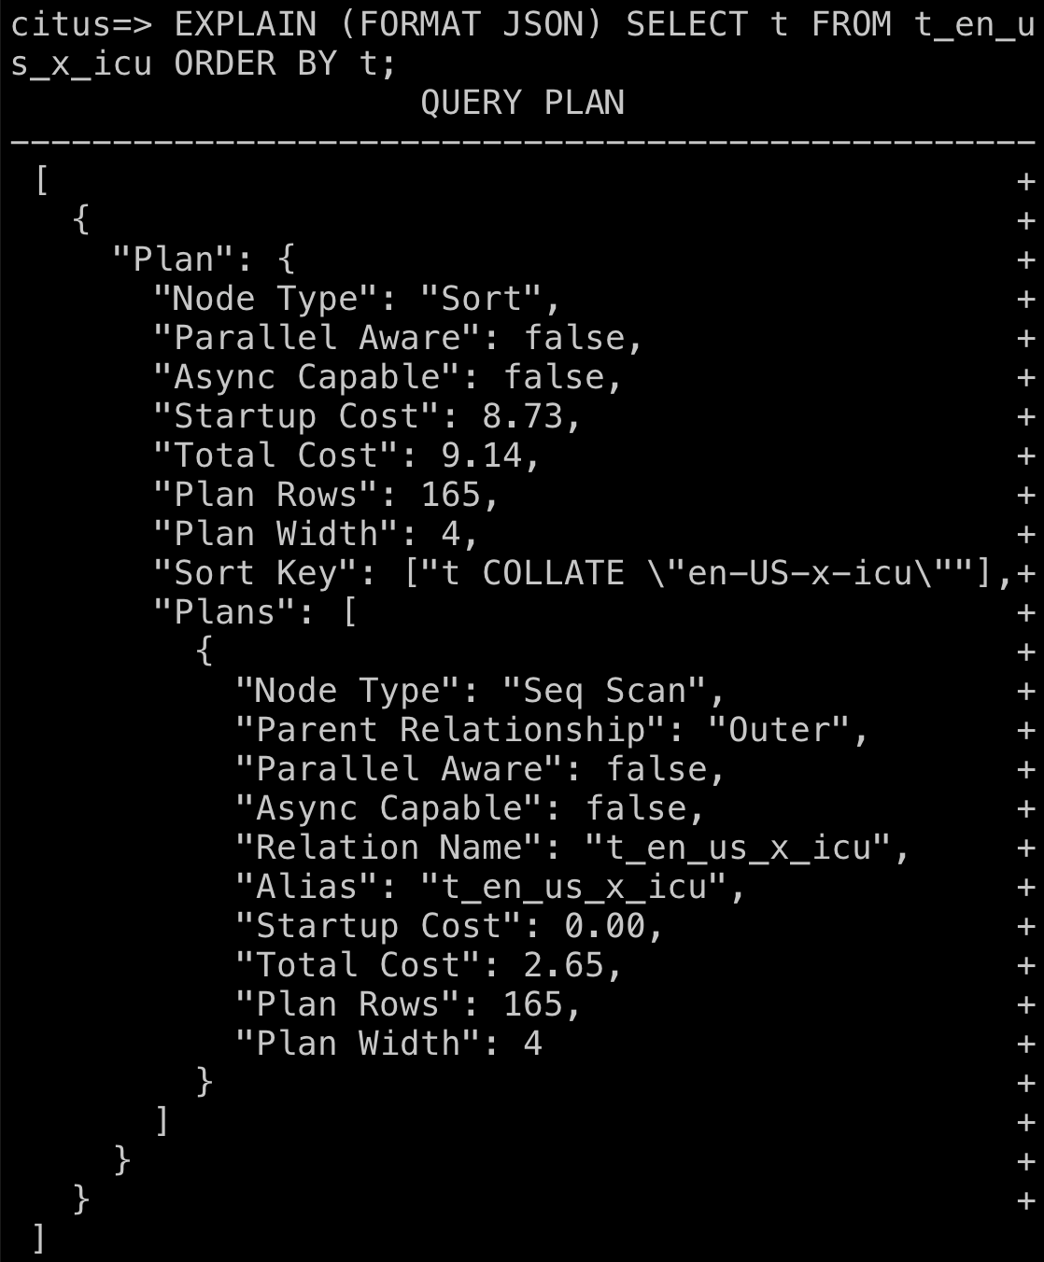
libc vs. ICU (English)
Cost Comparison > By EXPLAIN >

Slide 83
libc vs. ICU (Japanese)
Cost Comparison > By EXPLAIN >
libc (ja_JP.utf8)
ICU (ja-x-icu)

Slide 84

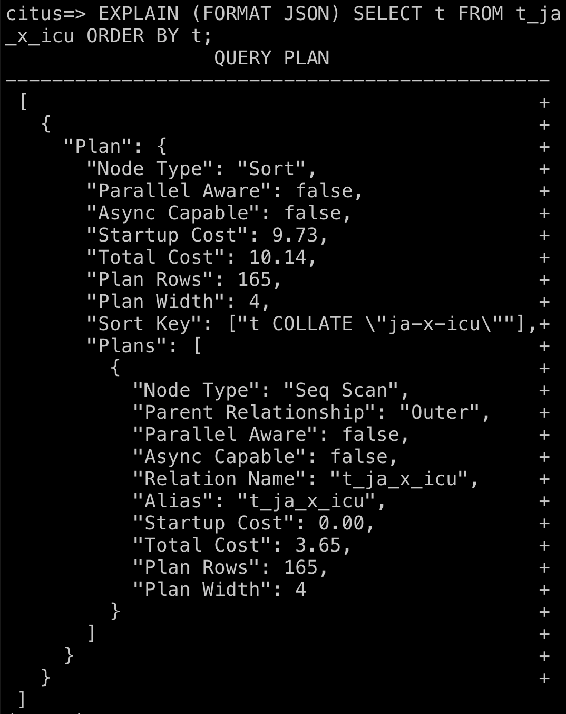
libc vs. ICU (Japanese)
Cost Comparison > By EXPLAIN >

Slide 85
ja-x-icu vs. ja-JP-x-icu
Cost Comparison > By EXPLAIN >
ja-x-icu
ja-JP-x-icu

Slide 86
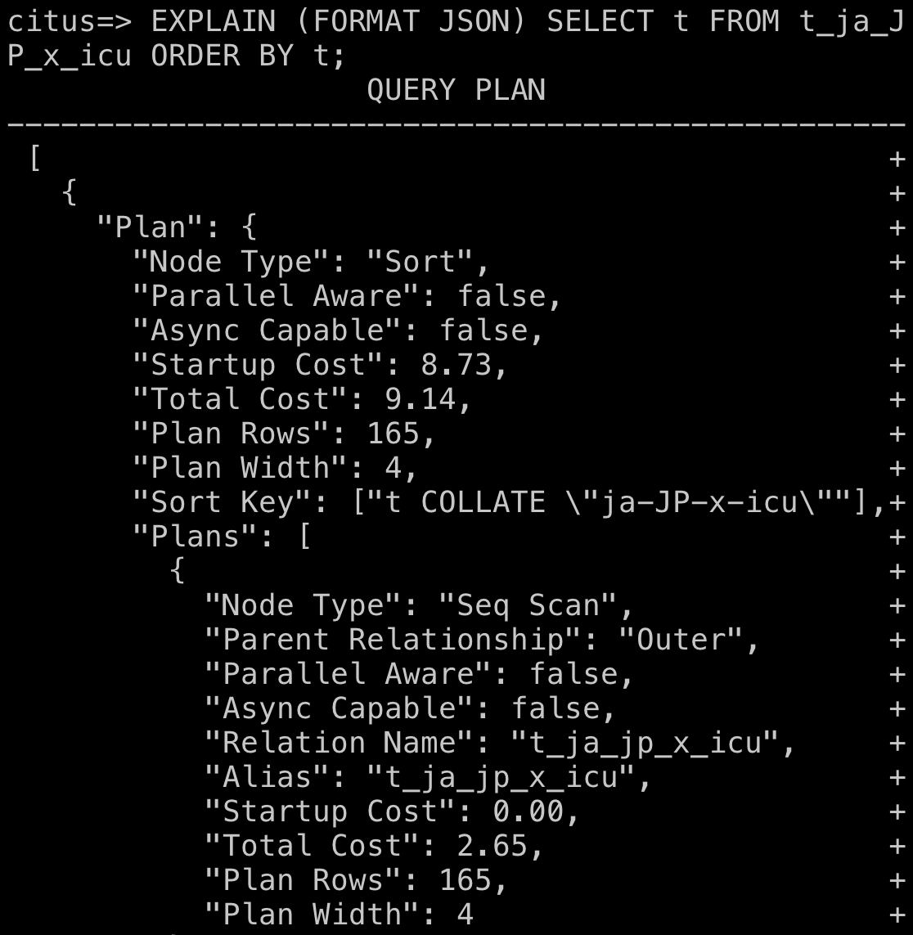
ja-x-icu vs. ja-JP-x-icu
Cost Comparison > By EXPLAIN >

Slide 87
en-US-x-icu vs. ja-JP-x-icu
Cost Comparison > By EXPLAIN >
en-US-x-icu
ja-JP-x-icu

Slide 88
en-US-x-icu vs. ja-JP-x-icu
Cost Comparison > By EXPLAIN >

Slide 89
ja-x-icu vs. ja-JP-x-icu with COLLATE clause
Cost Comparison > By EXPLAIN >
COLLATE "ja-x-icu"
COLLATE "ja-JP-x-icu"

Slide 90
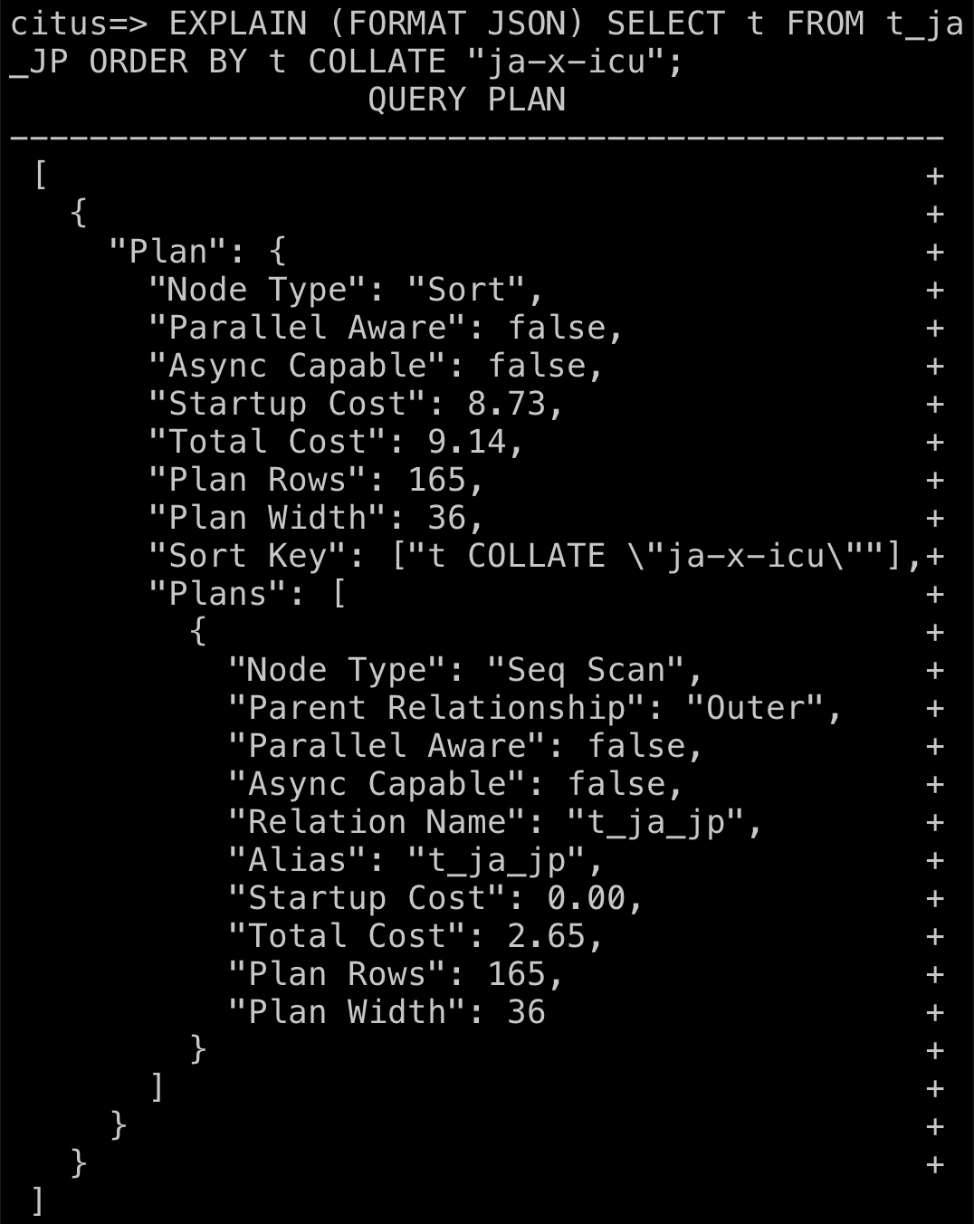
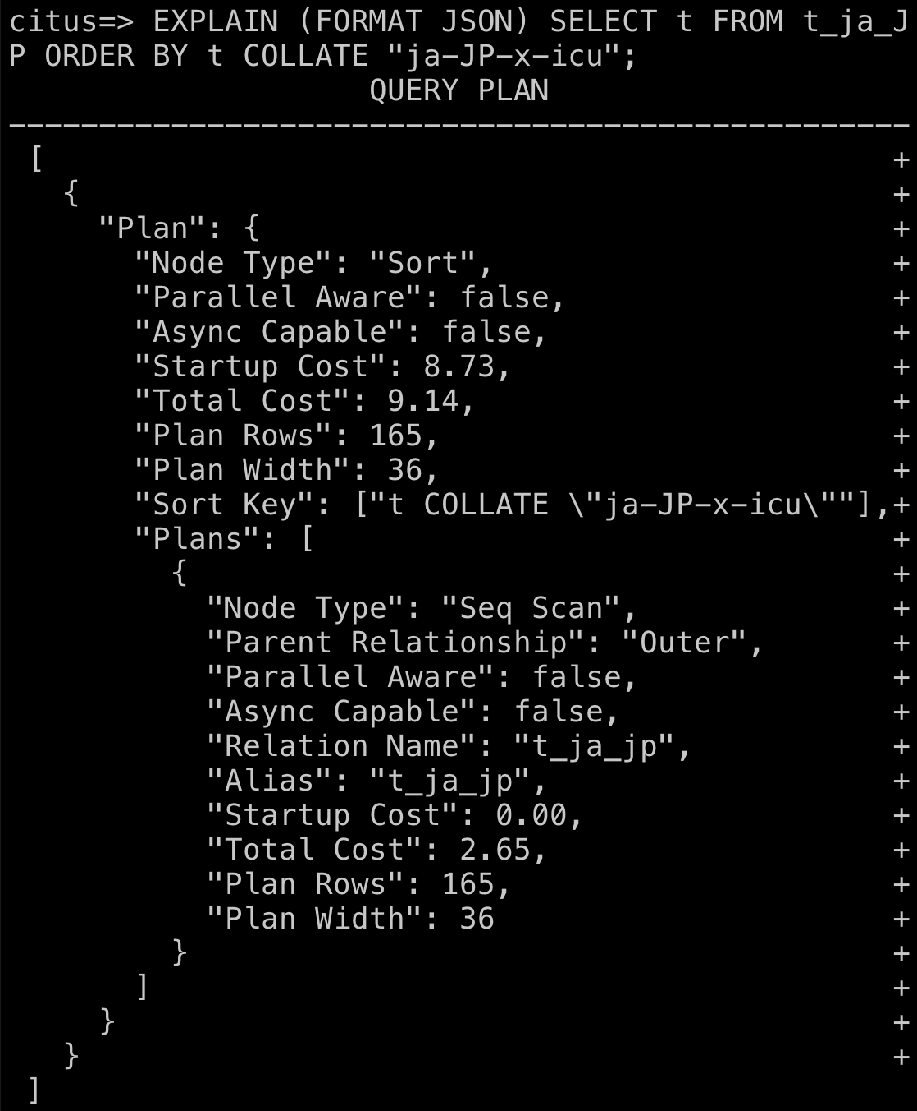
ja-x-icu vs. ja-JP-x-icu with COLLATE clause
Cost Comparison > By EXPLAIN >

Slide 91
Summary of Total Cost by EXPLAIN
Cost Comparison > By EXPLAIN >
SELECT t FROM ...
Slower
Notes:
About the calculated costs, all total costs except ‘ja-x-icu’ were the same. ‘ja-x-icu’ was worse than other collations. But specifying ‘ja-x-icu’ on ‘en_US.utf8’ table on-the-fly performed faster than that. Currently I’m not sure about the reason.

Slide 92
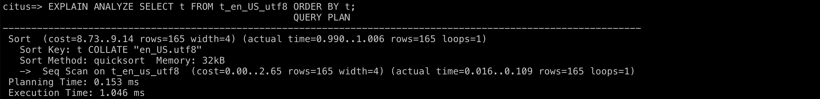
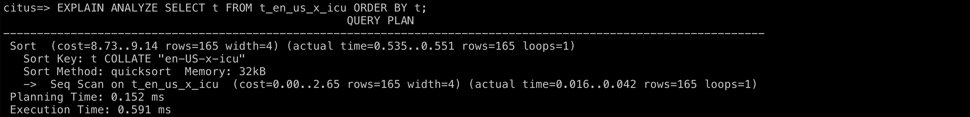
libc vs. ICU (English)
Cost Comparison > Actual time >
libc (en_US.utf8)
ICU (en-US-x-icu)
Notes:
Next, I’ll explain actual times using ANALYZE command.

Slide 93

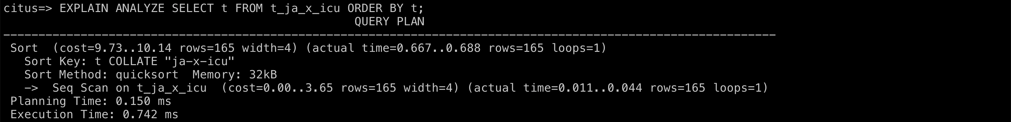
libc vs. ICU (Japanese)
Cost Comparison > Actual time >
libc (ja_JP.utf8)
ICU (ja-x-icu)

Slide 94
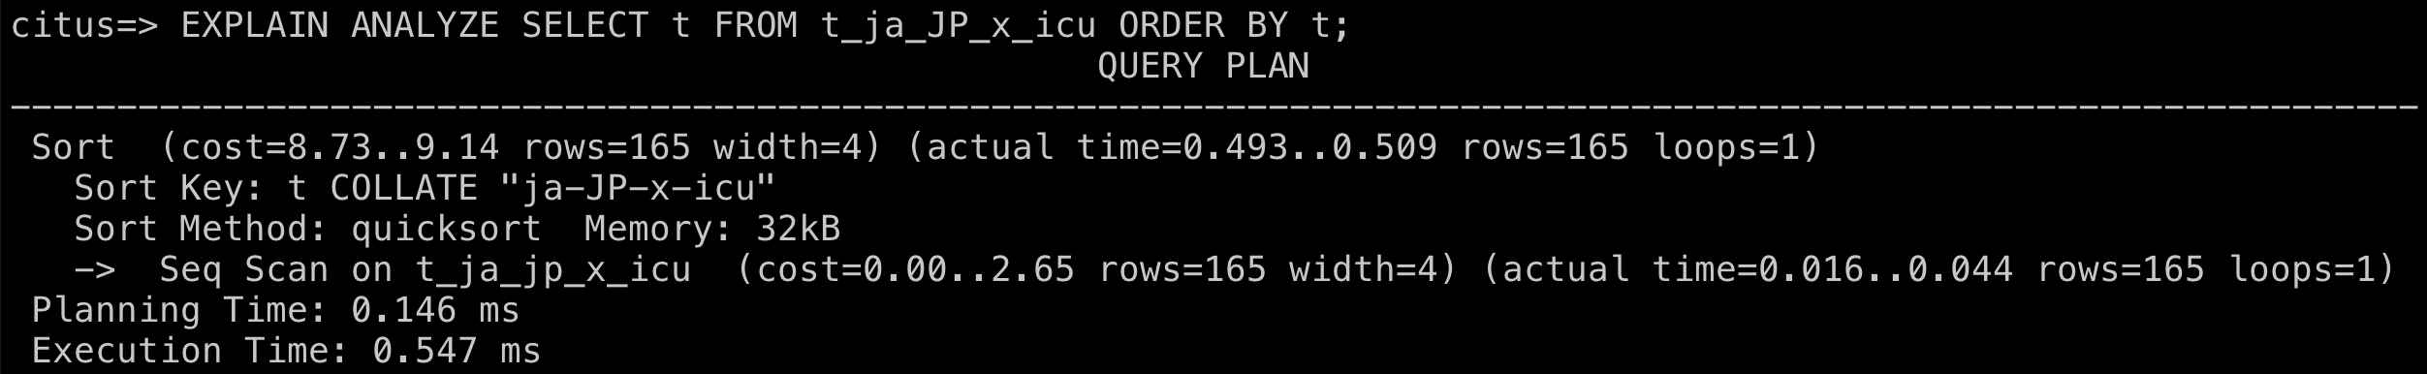
ja-x-icu vs. ja-JP-x-icu
Cost Comparison > Actual time >
ja-x-icu
ja-JP-x-icu

Slide 95
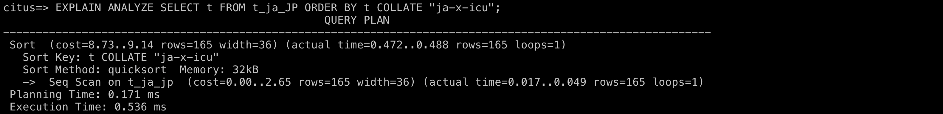
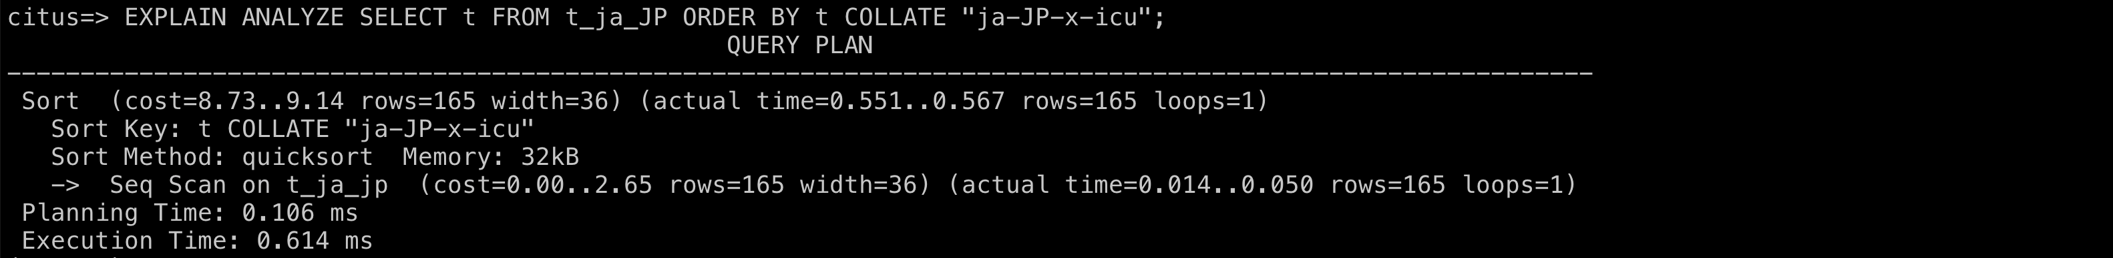
ja-x-icu vs. ja-JP-x-icu with COLLATE clause
Cost Comparison > Actual time >
COLLATE "ja-x-icu"
COLLATE "ja-JP-x-icu"

Slide 96
Summary of Actual Time by ANALYZE
Cost Comparison > Actual time >
SELECT t FROM ...
Slower
ms
* Each value is the median of 10-time ANALYZE execution results.
Notes:
I got the results 10 times for each collation and got the median for each of them. Here is the result of the total time comparison. The result was quite different from the calculated costs. ‘ja-JP-x-icu’ collation was the fastest in the results. The default collation ‘en_US.utf8’ was the second worst, so I recommend you to change the collation by specifying your collation for more performance.

Slide 97
Conclusion
Using Azure Database for PostgreSQL Hyperscale (Citus), you can specify locale and collation for each table (not database).
ICU collation is better than libc not only for the sort order but also the performance.
Setting up ICU collation for each table is better than using COLLATE clause with ICU collation for libc tables.
Notes:
So, the conclusion is following:
First, using Azure PostgreSQL Citus, you cannot specify your locale and collation for database. So, you must do it for tables. I noted it in red in this deck.
Second, ICU collation is better than libc not only for the natural sort order but also the actual performance.
Third, setting up ICU collation for each table is better than using COLLATE clause with ICU collation for default libc tables.

Slide 98
References
PostgreSQL: Documentation
https://www.postgresql.org/docs/
ロケール(国際化と地域化) | Let's POSTGRES
https://lets.postgresql.jp/documents/technical/text-processing/2
PostgreSQL 10のICUコレーションを使うと日本語を普通にソートでき、更に文字順序までカスタマイズできる – yohgaki's blog
https://blog.ohgaki.net/postgresql-10-icu-locale-collation-enables-natural-japanese-sorting
PostgreSQL Collations | Vertabelo Database Modeler
https://vertabelo.com/blog/collations-in-postgresql/

Slide 99
References
Azure Database for PostgreSQLでCollation(照合順序)を指定してCREATE DATABASEしたい - 浅草橋青空市場
https://asazure.hatenablog.jp/entry/2018/04/13/203114
Don't let collation versions corrupt your PostgreSQL indexes - Microsoft Tech Community
https://techcommunity.microsoft.com/t5/azure-database-for-postgresql/don-t-let-collation-versions-corrupt-your-postgresql-indexes/ba-p/1978394

Slide 100
Agenda
Introduction
A number of different character sets
Character Set Support
Locale-specific collation order
Locale Support
Collation Support
Notes:
That’s it about my presentation. I think all PostgreSQL users need to consider localization, especially collation no matter whether you are native English speaker or not, because of the sort order and the performance.

Slide 101



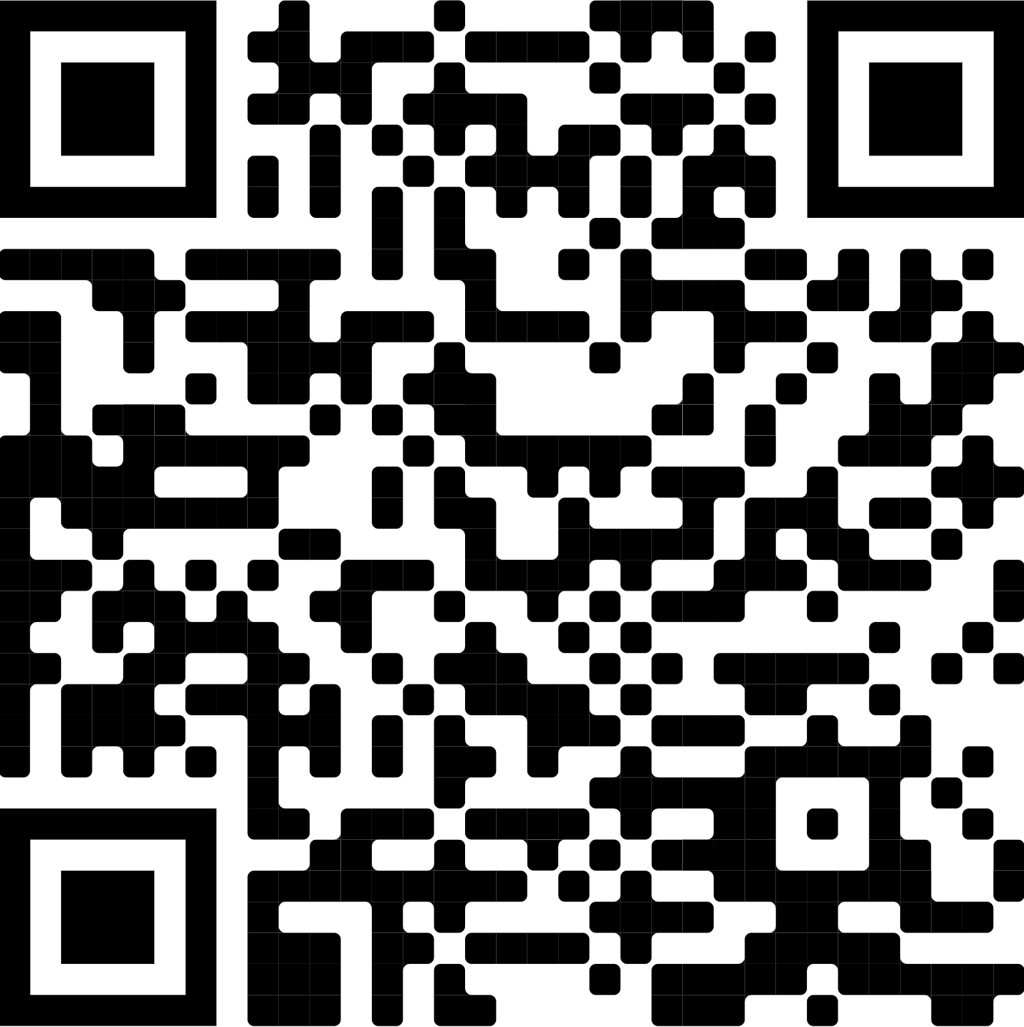


THANK YOU AND HAPPY HACKING!
Q&A and discussion
in Microsoft Open Source Discord
Keep in touch with the speaker?
#cituscon
@kske_t
@k14i
Notes:
Thank you for listening to my presentation.

